Slide 1
Chiba Campaign Daily Report
2022 12/6
B3 Shunya Mizobuchi
Notes:
顧さんは？
1

Slide 2
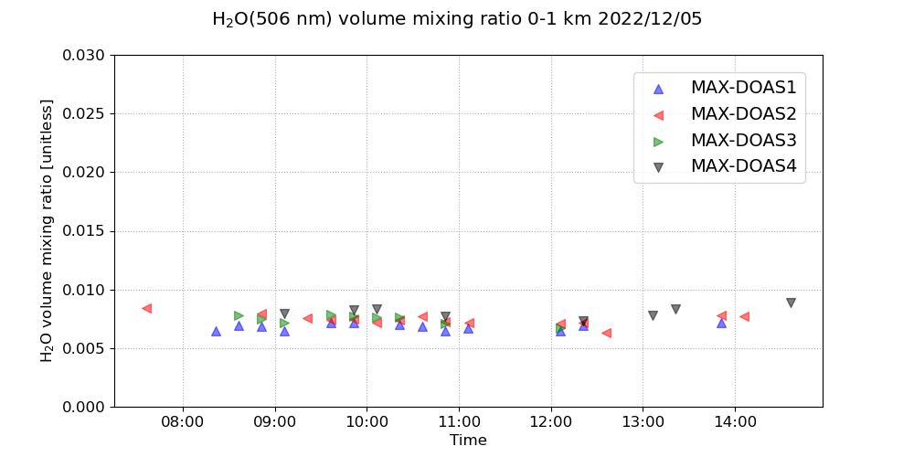
H₂O volume mixing ratio(4 Directions)

Slide 3
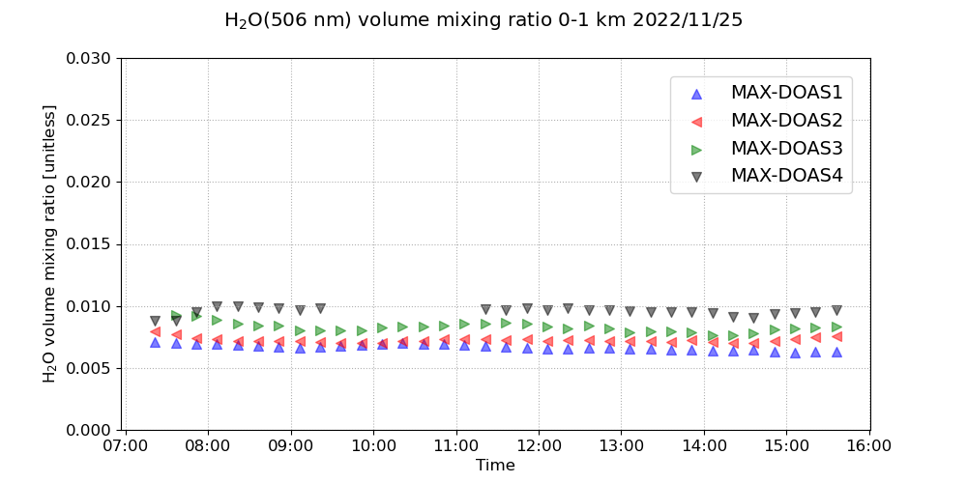
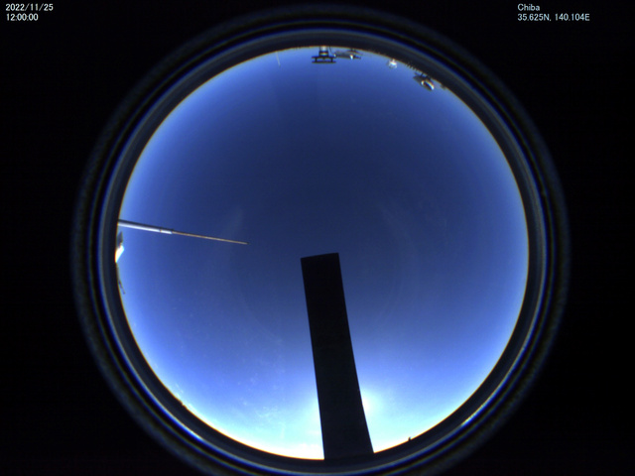
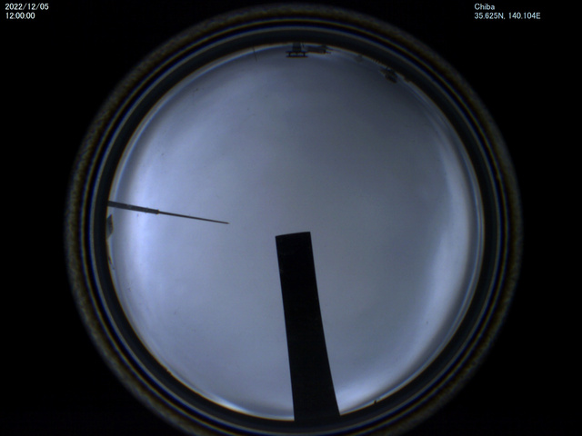
Consideration: Fluctuation of numerical values
Small fluctuation
Large fluctuation
Consideration
Consideration
Small fluctuations due to clear skies and stable atmospheric conditions.
Large fluctuations due to cloudy skies and unstable atmospheric conditions.
Sky image at 12:00 pm on 11/25
Sky image at 12:00 pm on 12/5

Slide 4
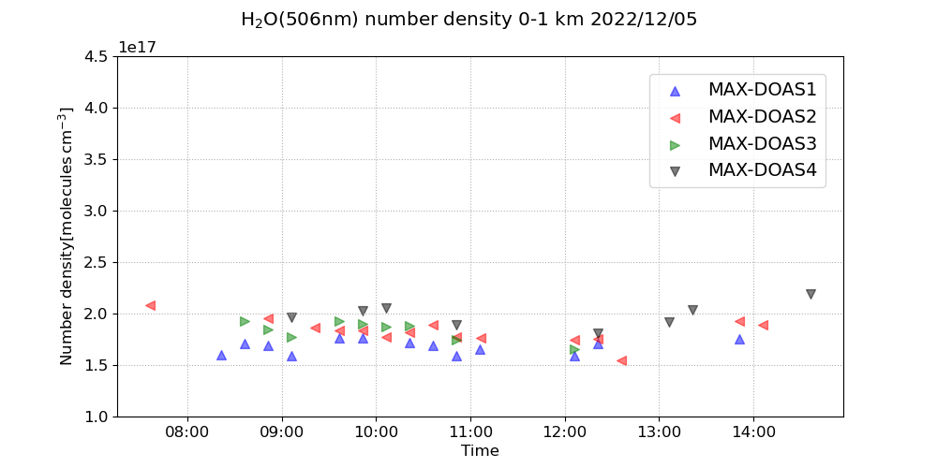
H₂O number density(4 Directions)

Slide 5
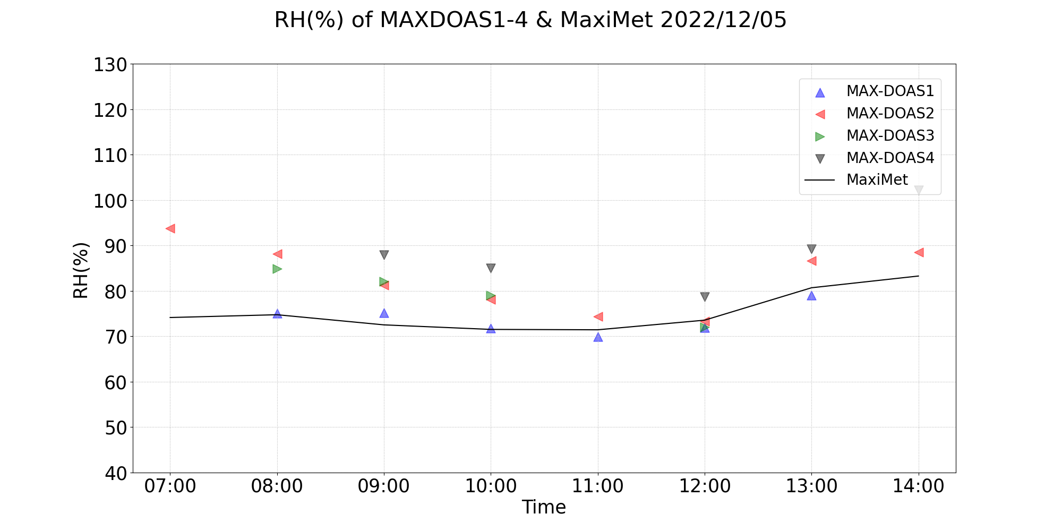
Comparison of RH between MAX-DOAS and Maximet

Slide 6
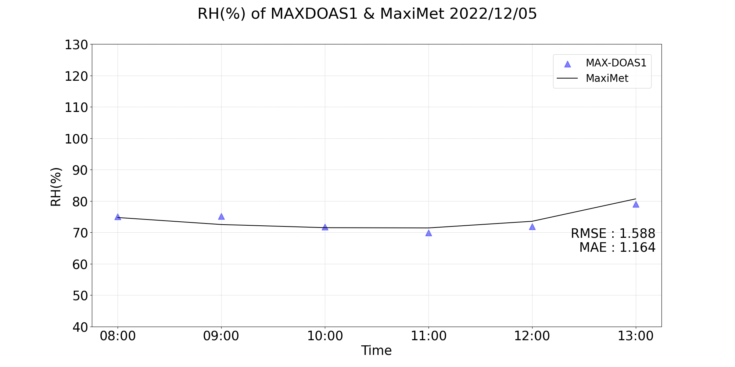
RMSE and MAE of RH(%)

Slide 7
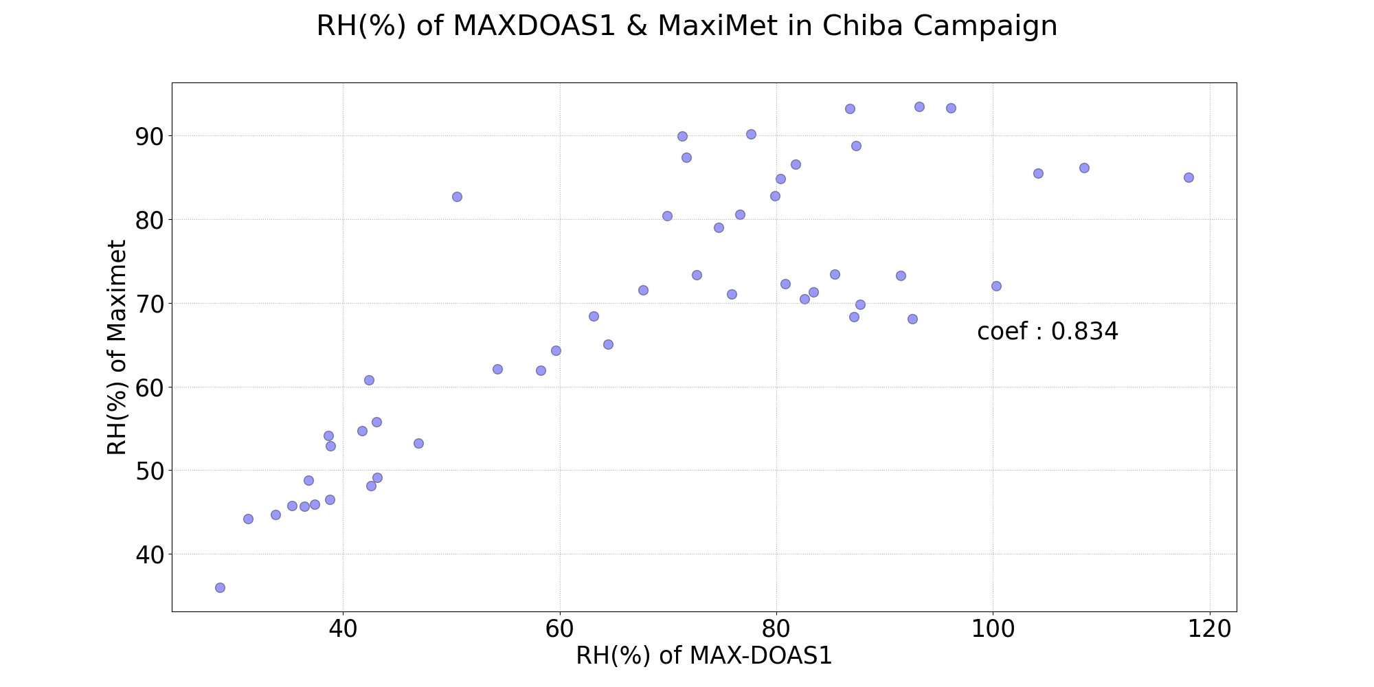
Correlation distribution of RH(%)

Slide 8
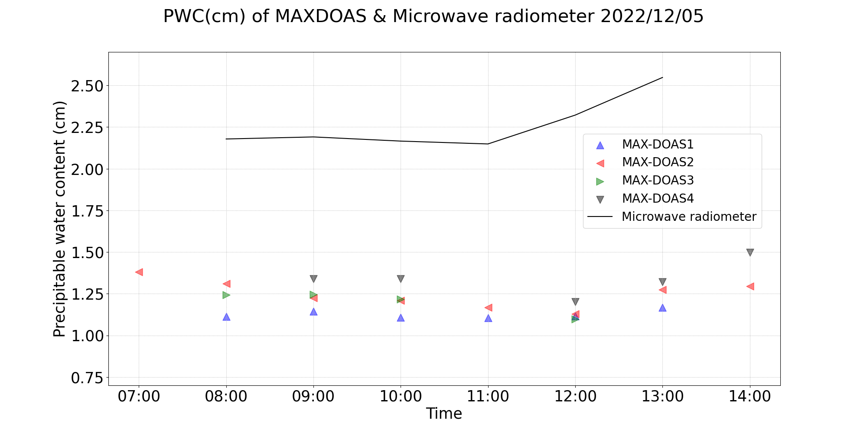
Comparison of PWC between MAX-DOAS and MWR

Slide 9
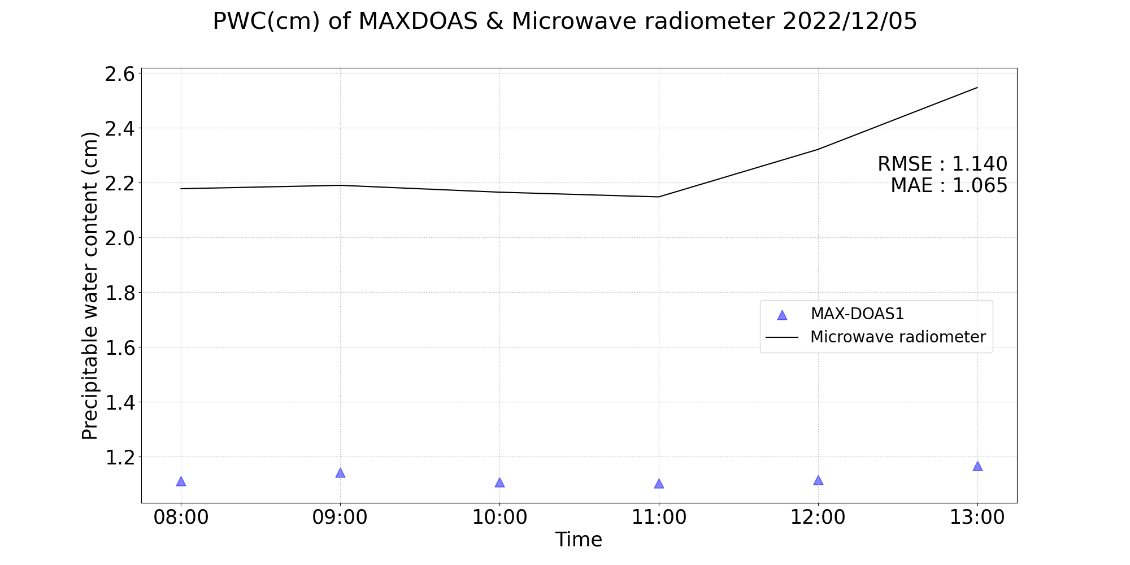
RMSE and MAE of PWC(cm)

Slide 10
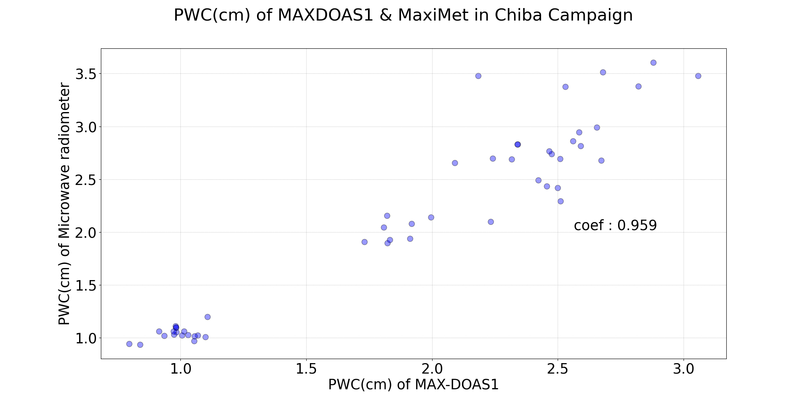
Correlation distribution of PWC(cm)

Slide 11
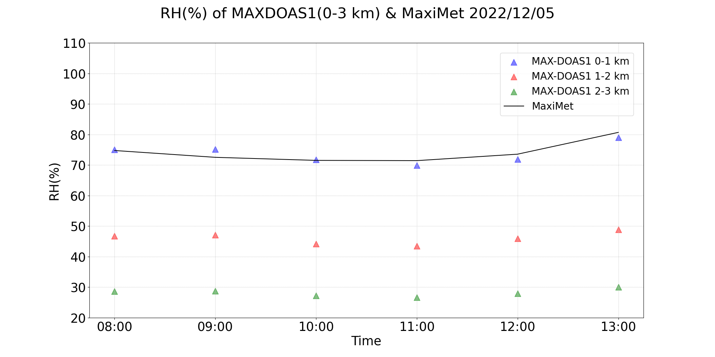
Comparison of RH between MAX-DOAS(0-3 km) and Maximet

